Slide 1
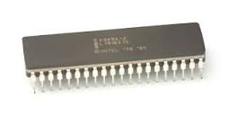
Basics of 8086 Microprocessor
Dr.N.Arulanand,
Professor,
PSG College of Technology

Slide 2
8086 Microprocessor - Keywords
CISC
29,000 transistors – semiconductor chip 3.2micron metre 32mm2
8088/8086
40 pins DIL or DIP
16-bit processor data bus
Machine cycle
8085 – 8-bit processor
Pipeline architecture
20 bit address bus

Slide 3
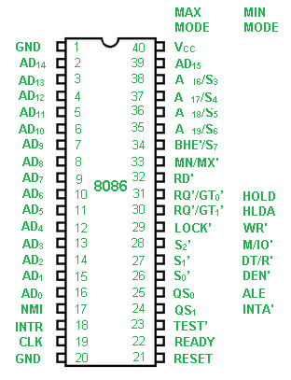
Pin Diagram of 8086

Slide 4
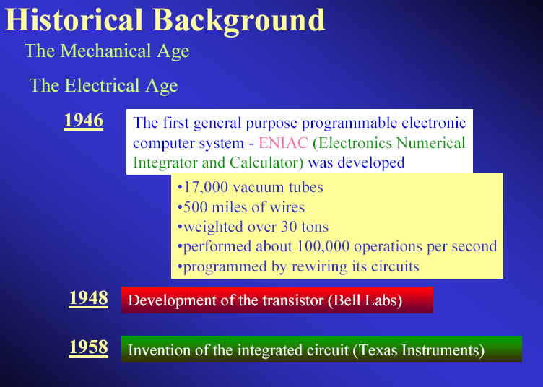

Slide 5
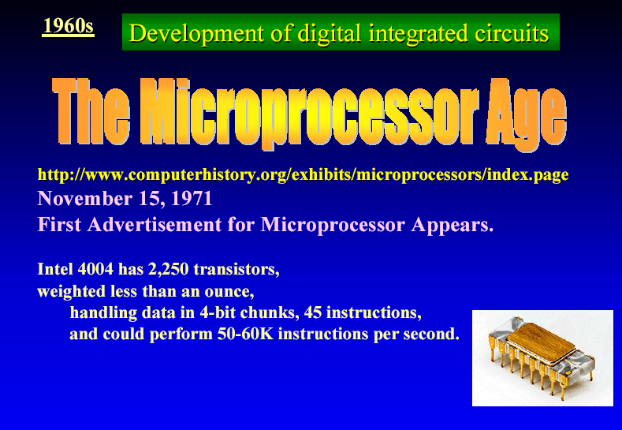

Slide 6
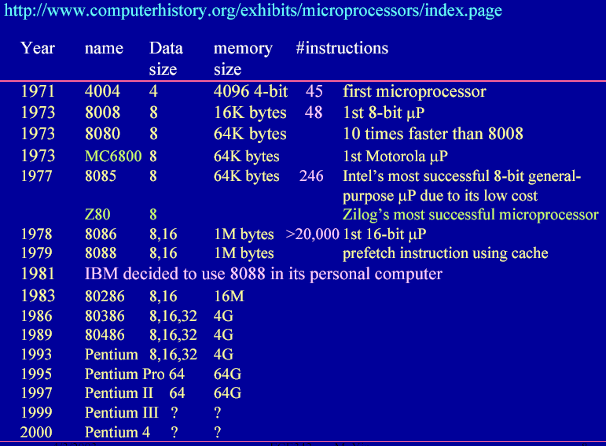

Slide 7
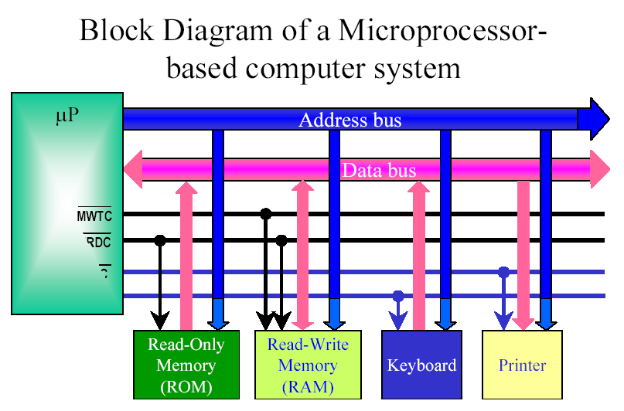

Slide 8
Is Intel 8086 RISC or CISC ?
CISC – Complex Instruction Set Computers
Refers to number and complexity of instructions
Improvements was: Multiply and Divide
The number of instruction increased from
45 on 4004 to:
246 on 8085
20,000 on 8086 and 8088
RISC – Reduced Instruction Set Computer
Executes one instruction per clock
Newer RISC - Superscaler Technology
Execute more than one instruction per clock

